Slide 1
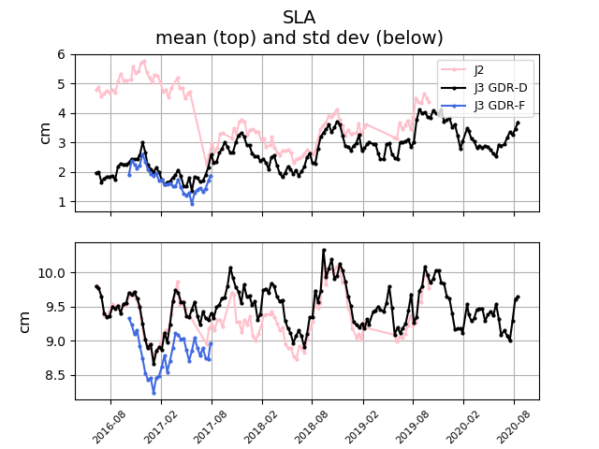
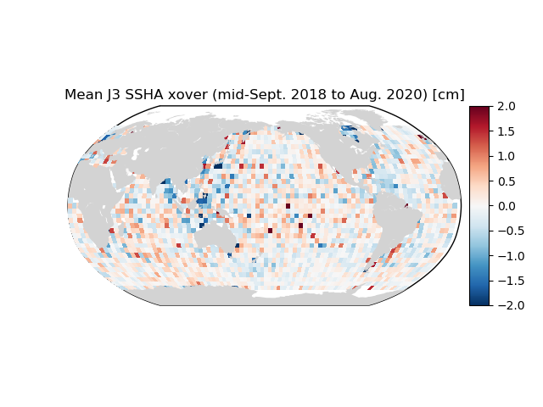
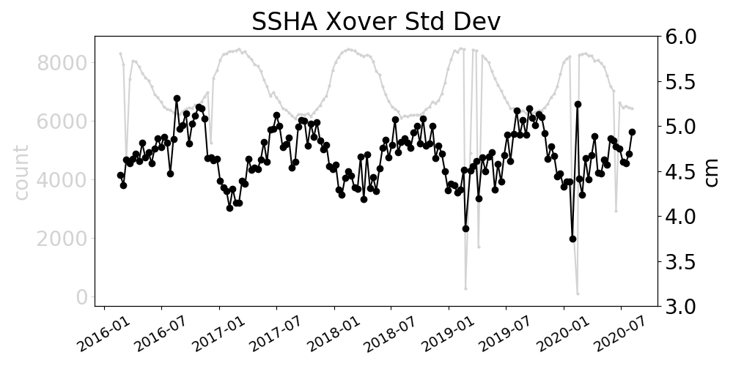
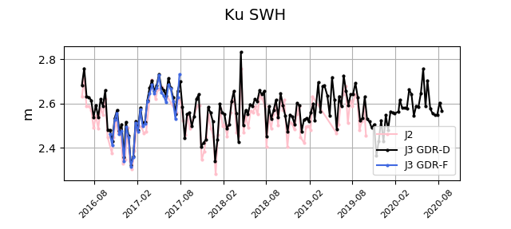
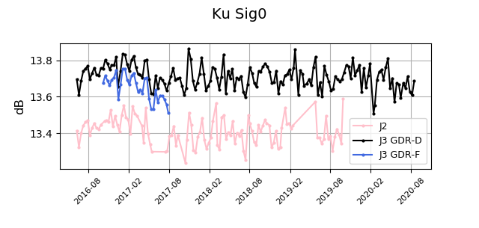
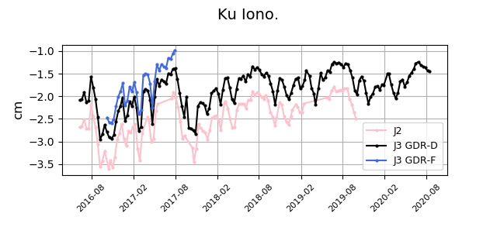
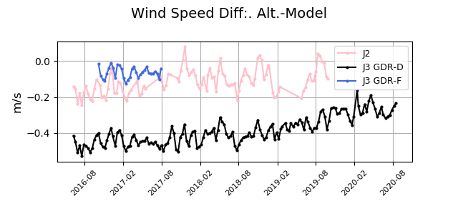
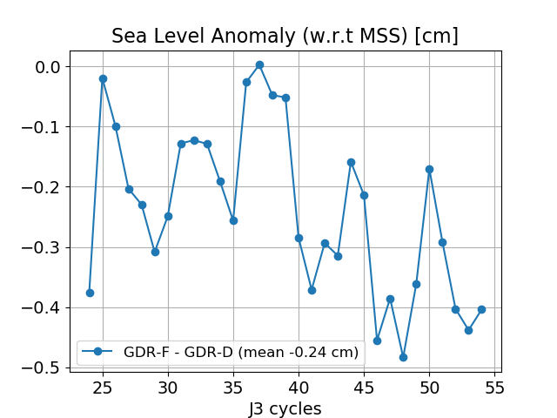
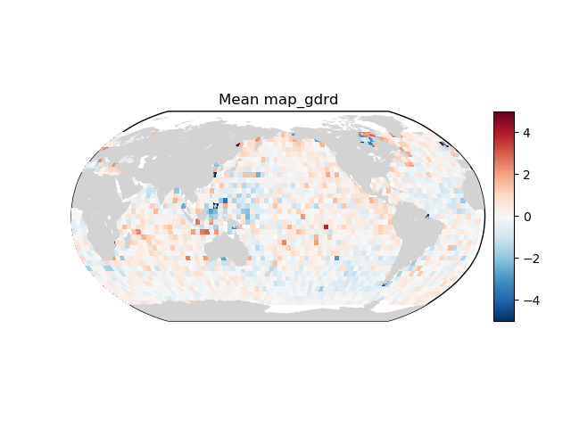
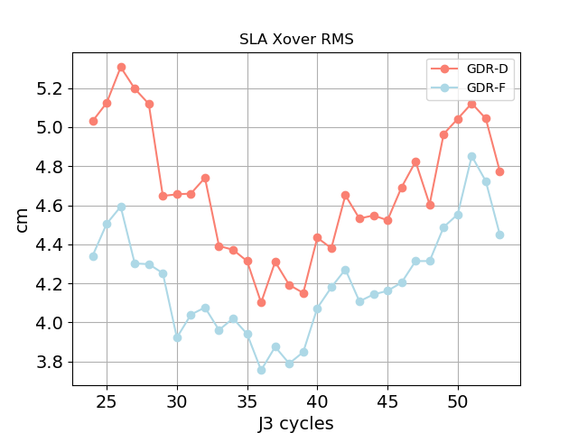
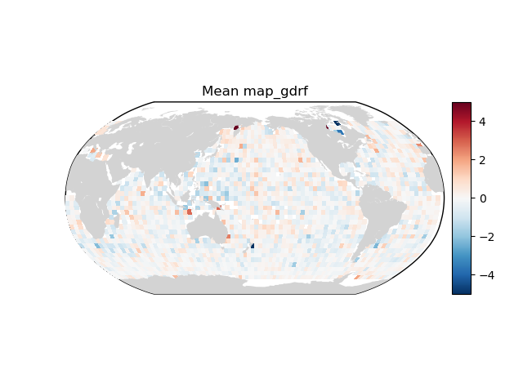
Results from Independent Calibration and Validation of Jason-3 and Jason-2
Jean-Damien Desjonquères¹, Matthieu Talpe¹, Shailen Desai¹, and Bruce Haines¹
¹Jet Propulsion Laboratory, California Institute of Technology, Pasadena, CA, United States
Summary
Jason-3 Satellite Main Events
The Jason-3 (J3) mission has been collecting sea level measurements along the reference 10-day repeat ground-track since February 2016. In this poster, we present a summary of calibration and validation results, which indicate that J3 mission continues to perform nominally.
The measurement performances for the J3 mission continue to excel. Altimeter parameters (SWH, sig0, etc.) and the sea level anomaly curve correspond to expectations in spite of maneuvers and safe hold events. The geographic distribution of sea surface height anomaly (SSHA) crossovers for the J3 mission contains cm-level geographically-correlated patterns. Means of along-track, ascending minus descending SSHA indicate that the J3 orbit standard change greatly attenuated a periodic hemispheric signal.
The Jason-2 (J2) spacecraft has been decommissioned on October 4, 2019. J2 data presented good agreement with J3 and high quality until the very end of the mission.
The next product standard (GDR-F) for Jason-3 shows improvements when compared to the current (GDR-D) standard.
Cycle 146 to 147: SHM due to anomaly with gyro that started on 31 January 2020 at 4:51 (UTC), and ended on 5 February 2020 at 08:52 (UTC)
Cycle 147: Second SHM that started on 5 February 2020 at 21:00 (UTC), and ended on 13 February 2020 at 8:40
Cycle 160: SHM due to anomaly with gyro #2 that started on 15 June 2020 at 21:50 (UTC) and ended on 19 June 2020 at 7:32
Jason-3 GDR-D SSHA Crossover Statistics
Jason-2 vs Jason-3 Along-Track Stats
Crossover results demonstrate the good performance and consistency of measurements for Jason-3 since the beginning of the mission.
Map of internal (asc.-des.) J3 crossovers over the last year shows small cm-level signal patterns. The excellent geographical homogeneity is explained by the GDR-F orbit standard introduced in GDR-D products since cycle 95 (see 2019 CalVal poster by Matthieu Talpe).
Over the last 12 months, no anomaly appeared neither for geographically-correlated errors nor for the standard deviation values which are consistent over the whole mission period
Timeline
October 4, 2019
End of J2 mission
J3 launch
J2/J3 tandem:
~90 secs apart
J2 interleaved orbit
J2/J3: ~5 days apart
First J2 geodetic cycle
Long Repeat Orbit (LRO)
Second J2 geodetic cycle
Interleaved Long Repeat Orbit (iLRO)
Jason-2 cycles:
281
304
327
500
537
600
635
644
Jason-3 cycles:
1
J2 SHM
52
90
J2 SHM
125
Sea Level Anomaly (SLA)
SLA mean difference decreases by 2.5 cm after the J2 LRO due to an MSS update. MSS_CNES-CLS11to MSS_CNES_CLS2015
The J2 std. dev. is similar to J3 within 1 mm, except over the J2 LRO when it is 3 mm smaller.
The J3 along track SLA std will improve in GDR-F as it benefits from the MSS update (MSS_CNES_CLS2015).
Xovers J3 GDR-D
Mean (Asc/Desc) Difference
Sept 2019 – Aug 2020
MSS change
cm
Statistics of J2-J3 (GDR-D) SLA differences over different J2 phases
Statistic [cm] | Tandem + Interleaved | LRO | iLRO
J2-J3 Mean | 3.0±0.4 | 0.5±0.2 | 0.4±0.2
J2-J3 Std. Dev. | 0.0±0.1 | -0.3$±$0.1 | -0.1$±$0.1
Altimeter Parameters
Jason-3 GDR-F standard evolution Performances over test dataset
New Jason-3 GDR-F standard will be soon available for users. Cycles 24 to 53 have been generated and assessed in a preliminary CalVal analysis.
Some parameters are slightly shifted in GDR-F when compared to GDR-D as shown in the J2 vs J3 time series. In particular the use of the MSS_CNES_CLS2015 generates an offset of +23.8 mm due to a change of the reference time with respect to the MSS_CNES_CLS2011 version and the update of SSB model generates an offset of -19,1mm [communication with CNES/CLS]. The resulting SSHA is offset by -0.24 cm over cycles 24 to 53 by comparison to the GDR-D standard with overall a good agreement between the two.
Crossovers demonstrate the improvement of the SSH estimation with a reduction of the standard deviation as well as an improvement in the geographical homogeneity: std reduction of the order of 0.4 cm over the test cycles).
Further details about J3 GDR-F update are available in the CNES/CLS presentation.
SWH, sig0, ionospheric correction from Ku-band, and the altimeter wind speed differences of means and std. dev. are stable and consistent since the J3 launch.
While the echoes retracking for GDR-F has almost negligible effects (see SWH) besides a shift in the sigma0 (due to a new cal-2 normalization algorithm), some derived values will present some significant bias between the 2 standards due to an update of the SSB tables and the alignment of the altimeter windspeed with ECMWF.
SLA Difference
GDR-F – GDR-D (cm)
Xovers GDR-D
Mean (Asc/Desc) Difference
cm
Radiometer Parameters
Xovers Standard Deviation (cm) GDR-F vs GDR-D Comparison
Xovers GDR-F
Mean (Asc/Desc) Difference
cm
The radiometer wet path delay difference wrt ECMWF and the radiometer wind speed from J2 present visible drifts wrt J3 in their means since the beginning of the J2 interleaved orbit. J3 appears more stable when compared to model.
Over this time interval, the J2-J3 wet path delay minus difference varies between -0.1 and -0.2 cm.
J3 GDR-F Wet Path Delay is much better aligned with model as compared to GDR-D.
J3 GDR-F uses absolute calibration that is expected from Sentinel-6.
Geographical patterns are reduced for J3 GDR-F Xovers compared to GDR-D
Contact: jean-damien.m.desjonqueres@jpl.nasa.gov
OSTST 2020. Venice, Italy (Virtual Sessions).
© 2020. California Institute of Technology. Government sponsorship acknowledged.

